Slide 1
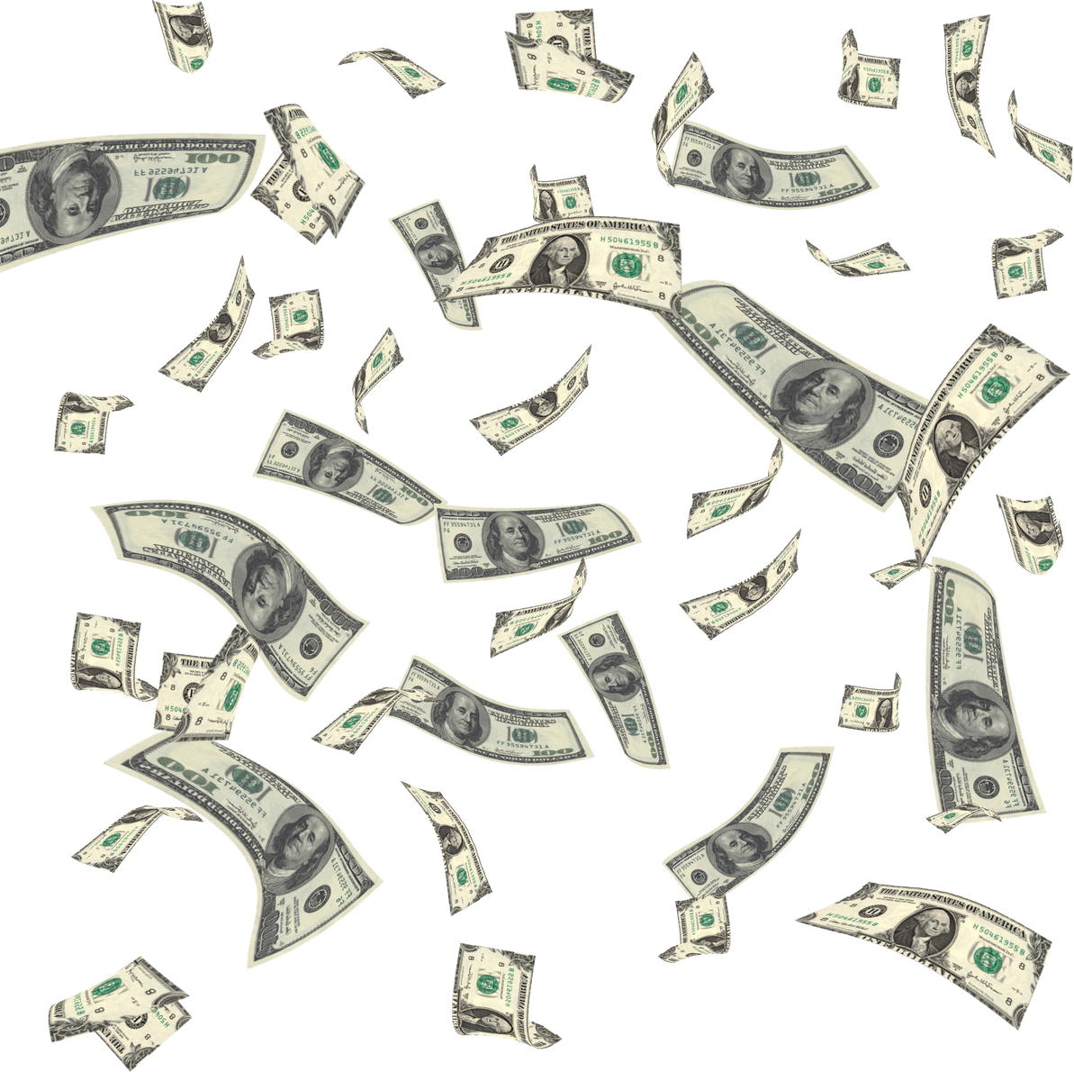

Universal Basic Income
(UBI)

Slide 2
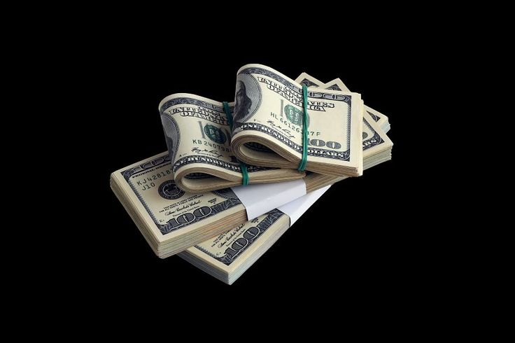
DO YOU KNOW?
According to the United Nations Millennium Development Goals (MDG) program, approximately 80 million people out of 1.2 billion Indians, roughly equal to 6.7% of India's population, lived below the poverty line of approximately ₹90 per day in 2019. Additionally, 84% of Indians lived on less than approximately ₹495 per day.
More than 10 crore Indian population is unemployed. India’s Part Time Employment = 24% of Total Employment rate.
WHAT IF?
Government of India starts giving us all a regular, unconditional sum of money, regardless of our income, employment status, or other factors.
WHAT IS UBI?
The Concept of UBI is Shifting of the poverty line.
Universal basic income is an income support mechanism intended to reach all the citizens of a given population, regardless of their income or employment status.

Slide 3


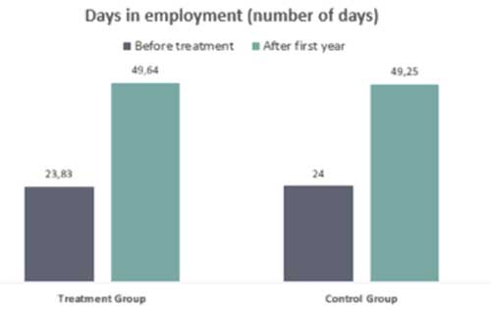

Here Is How It Works!
Regular Payments: Citizens receive a fixed sum of money at regular intervals, typically monthly.
Unconditional: There are no requirements or means tests to qualify for UBI. Everyone receives the payment, regardless of their income, employment status, or other factors.
Cash : UBI payments are typically made in cash, giving recipients maximum flexibility in how they spend the money.
Universal: Available to everyone within the defined population.
Case Studies and Experiments :
1. Finland (2017-2018) :
2,000 unemployed people aged 25-58 where given €560 (52059 IR) per month.
Key Findings:
Improved mental health.
Increased entrepreneurship.
But had limited effects on employment.
2. Canada (2016-2019) :
1500 people in Canada where given $1000 (83,883 IR) per month.
Key Findings:
Increased spending in local businesses
Reduced stress and anxiety
Improved financial stability.

Slide 4
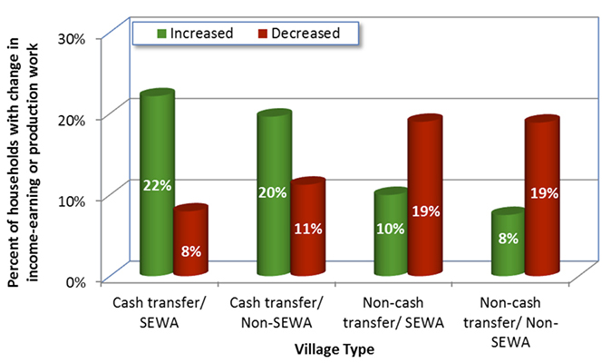
Case Studies & UBI history in India :
3. Madhya Pradesh UBI pilot (2011-2012) :
6000 people from 9 villages where given a small amount of
Rs 200 to adults and Rs 100 to children Monthly.
One village served as a control group.
Key Findings:
Increased household income and reduced poverty.
Improved education and health outcomes.
Empowerment of Women: Women, especially in SEWA (Self Employed Women’s Association) -organized villages , gained greater control over household finances, leading to more economic independence.
Economic Survey of India 2016-17:
The survey, prepared by then Chief Economic Adviser Arvind Subramanian, proposed UBI as a tool to address the challenges of economic insecurity and social welfare.
Key Proposals: A basic income of ₹7,620 per annum (about $113 USD) for all citizens.
But it did not recommend immediate implementation but emphasized the need for further research and experiments.
Sikkim UBI Proposal (2019) :
In 2019, the state of Sikkim announced plans to implement a UBI scheme by 2022. The proposal came from the Sikkim Democratic Front (SDF) party, which aimed to offer a basic income to all residents.
However, the plan did not move forward due to a change in government in 2019, and political and economic challenges continue to make its implementation uncertain.

Slide 5
Here's What The Most Successful People in the World Think About UBI !
Elon Musk said, ‘ due to mass disruption in employment caused by automation, I don’t think we’re going to have a choice. I think it’s going to be necessary. There will be fewer and fewer jobs that a robot cannot do better ’.
Mark Zuckerberg said , ‘ We should explore ideas like universal basic income to make sure that everyone has a cushion to try new ideas ’.
Bill Gates, thinks its not the right time to implement it. Gates feels that resources are too limited to make it happen now, and instead more targeted programs need to happen first.
Barak Obama said , ‘ Whether a universal income is the right model — is it gonna be accepted by a broad base of people? — that’s a debate that we’ll be having over the next 10 or 20 years. ’
Future of UBI Worldwide :
While UBI is still in its experimental phase, but the results are promising in many cases. Full-scale national implementation has yet to be achieved.
The future of UBI will likely involve more experimentation and gradual, targeted adoption, particularly in response to growing concerns about job displacement due to automation and other technological advancements.

